Slide 1
INTEL IMAGE CLASSIFICATION
FNU Mohammad Abdul Khalid

Slide 2
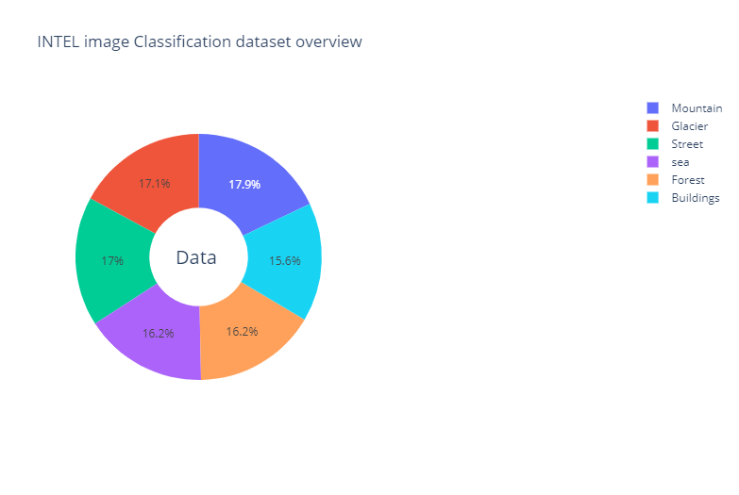
Data

Slide 3
Data
Buildings: 2191
Forest: 2271
Glacier: 2404
Mountain: 2512
Sea: 2274
Street: 2382

Slide 4
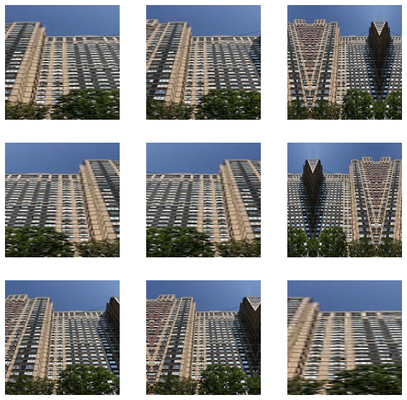
Data augmentation
A resulting image after Data augmentation with random flip, rotation, zoom and translation

Slide 5
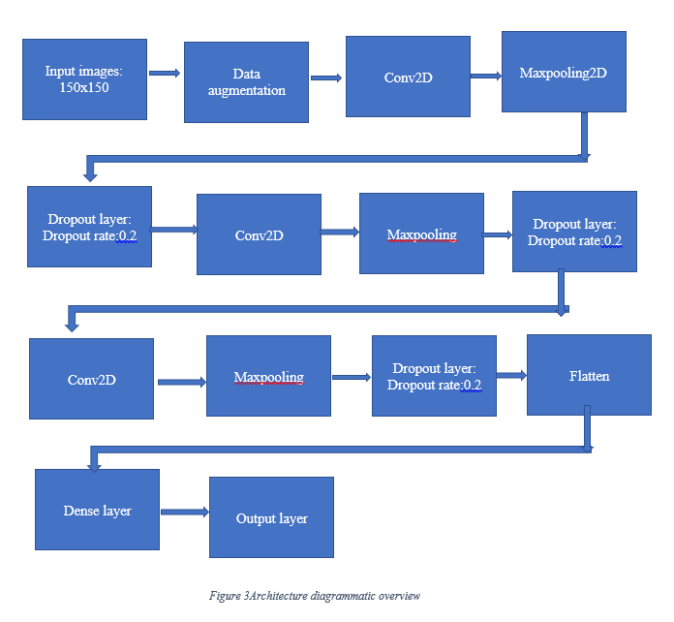
Model architecture

Slide 6
Hardware
Model Training Device(laptop)
HP Elitebook 840 G4 Laptop
Operating system: windows 10 pro 64-bit
Processor: Intel(R) Core™ i5-7300 CPU@2.60GHz 2.71GHz
GPU: none
RAM: 16GB
Hardware implementation device
Rasberry pi 3

Slide 7
Design
After the preprocessing with data augmentation was done the data was split into train test and validation using the built in function from sklearn[7]
Tensorflow Dataset information:
Tensorflow training batch size=32
Image Height=150
Image width=150
Steps per epoch=373

Slide 8
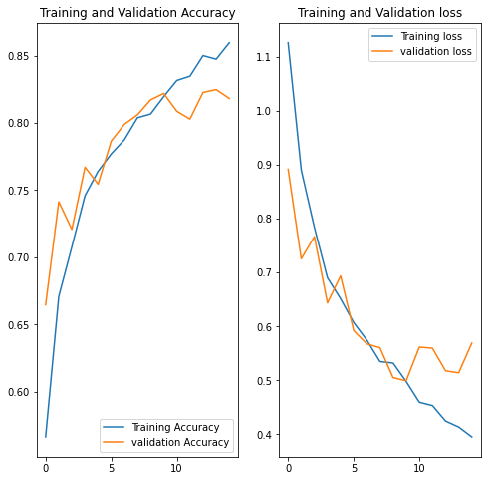
Training and validation Accuracy and loss plots

Slide 9
Results
The model was successfully trained using the architecture shown in slide5. The model, using the saved weights during training, was evaluated using the test dataset. The model was found to have an accuracy of 81% over the test dataset and had a loss of 0.318. Apart from that the model was successfully implemented on hardware as well using tflite on Rasberrypi version 3. The model gave a correct output when input as an image of any size was given

Slide 10
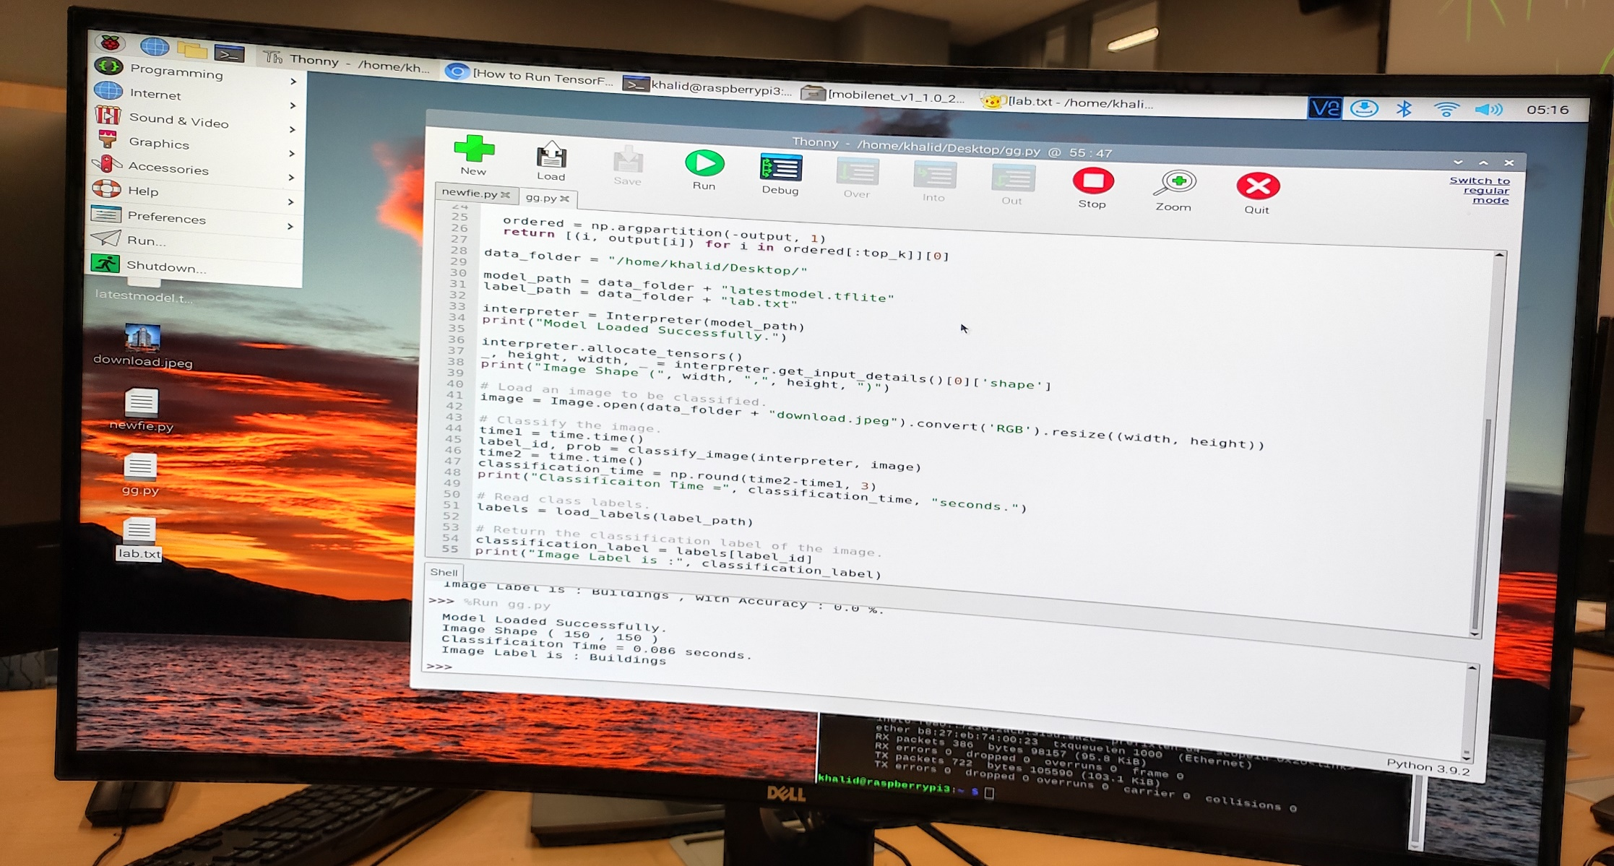
A screenshot of the output of the rasberrypi model using tflite

Slide 11
Discussion
The model was only trained for 6 categories of places as mentioned earlier if we want to increase the number of output categories to more than 6 the model needs to be trained with more images of new classification. The model can be further improved by using more number input data and much better model architecture.

Slide 12
Conclusion
The objective of this project was to implement Convolutional neural networks to classify images of 6 categories in INTEL image dataset using python and tensorflow framework. The resulting accuracy of the model was acceptable since it was evaluated to be 81% for the test dataset.

Slide 13
References
[1]https://datahack.analyticsvidhya.com
[2] https://www.tensorflow.org/api_docs/python/tf/keras/layers/Conv2D
[3]https://www.tensorflow.org/api_docs/python/tf/keras/layers/Dropout
[4]https://www.tensorflow.org/api_docs/python/tf/keras/layers/MaxPool2D
[5]https://www.tensorflow.org/tutorials/images/data_augmentation
[6]https://www.tensorflow.org/api_docs/python/tf/keras/layers/Flatten
[7]http://scikit-learn.org/stable/modules/generated/sklearn.model_selection.train_test_split.html
[8]https://www.tensorflow.org/api_docs/python/tf/keras/optimizers/Adam

